Slide 1

TENERIFE WINTER SESSIONS GuarandingaTECH TenerifeDEV

Slide 2








NUESTROS PATROCINADORES
Web3 Island
Makers
Sponsors
#Thanks

Slide 3






Luis Mañez
Ruben Toribio
Chief Architect @ ClearPeople
Co-founder @ RocketMind Academy
MS MVP M365 Development
M365 Architect / IA Developer @ DNV
Co-founder @ RocketMind Academy
@Rtoribiog
3
@luismanez
@Rtoribiog
@luismanez
linkedin.com/in/rubentg
linkedin.com/in/luismanez

Slide 4
01
RAG Pattern

Slide 5
Bringing Private Knowledge to LLMs
Fine tuning
Learn new skills
Retrieval
augmentation
Learn new facts

Slide 6
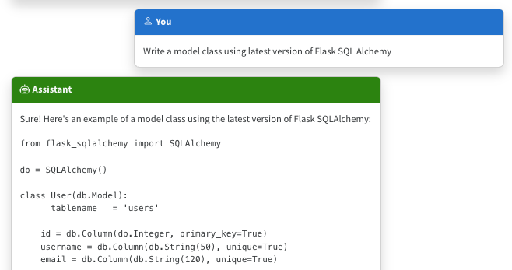
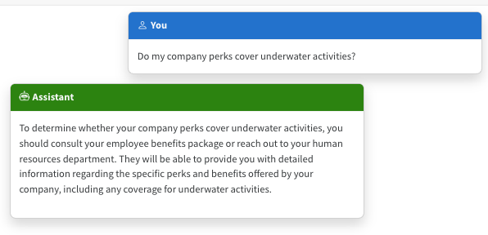
The Limitations of LLMS
Outdated public knowledge
No internal knowledge

Slide 7
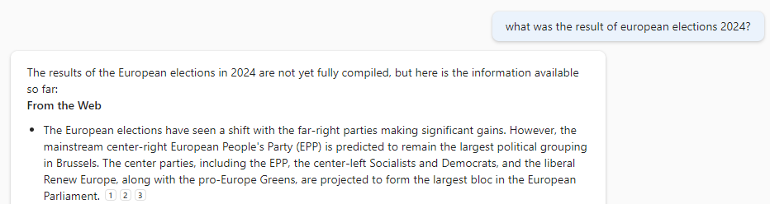
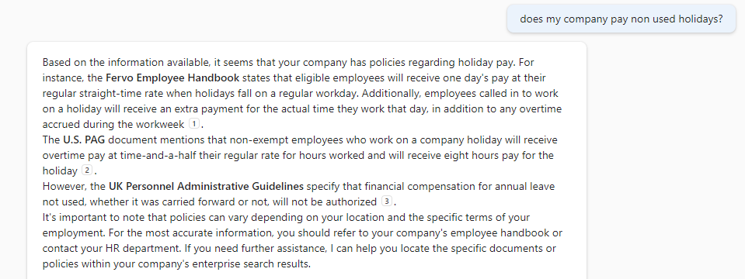
The benefit of RAG
Up-to-date public knowledge
Access to internal knowledge

Slide 8




RAG – Retrieval Augmented Generation
Yes, your company pays non used holidays ¹
Do my company pay non used holidays ?
User
Question
Document Search
Large Language Model

Slide 9
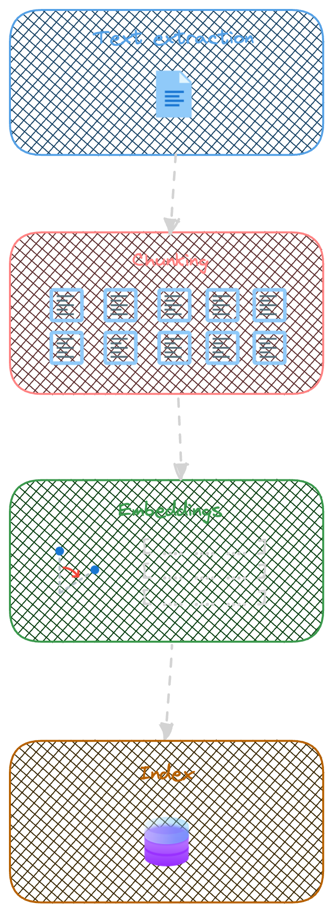
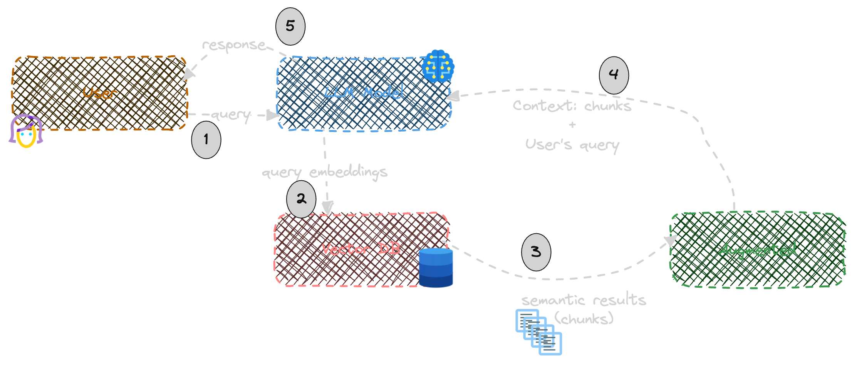
Indexing
Retrieval – Augmented - Generation

Slide 10
From POC → PROD: The Top Questions
Cost / Config / Scale
Accuracy
Ingestion and Integration
How can I optimize costs when scaling my RAG app?
What are the key factors that drive cost when deploying RAG solutions?
What SKU size do I select when going to PROD?
What techniques are used to enhance the accuracy of retrieval systems?
I built a basic RAG solution and it’s somewhat accurate. What are some advanced RAG strategies I can use to get even better?
How do I bring data from external data sources?
How do I ingest document effectively and efficiently?

Slide 11
Top challenges we have
Accuracy
Cost
Latency
Enhance chunking methods.
Refine content and document formatting for better processing and chunking.
Improve chunking and storage efficiency.
Develop more cost-effective and faster models.
Implement quicker models.
Continuously measure, monitor, and improve.

Slide 12
01
LangChain

Slide 13
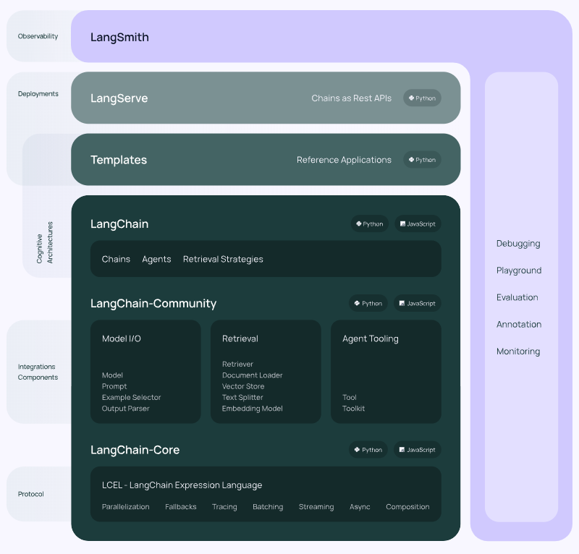
Lang Chain
Open-source library framework
https://github.com/langchain-ai/langchain
Build context-aware reasoning applications
Can run serverless or as a service
Python and JavaScript
Web pages
PDF
Images
Word
PowerPoint
Excel
Markdown
Text
JSON
HTML

Slide 14
02
KernelMemory

Slide 15
Kernel Memory
OpenSource library lead by Microsoft
https://github.com/microsoft/kernel-memory
Integrated with Semantic Kernel
Can run serverless or as a service
.NET
Data Formats
Vector Databases
File storage
LLMs
Web pages
PDF
Images
Word
PowerPoint
Excel
Markdown
Text
JSON
HTML
Azure AI Search
Elasticsearch
MongoDB Atlas
Qdrant
Redis
… and more
Disk
Azure Blobs
MongoDB Atlas
In memory (volatile)
Azure OpenAI
OpenAI
LlamaSharp
Anthropic

Slide 16
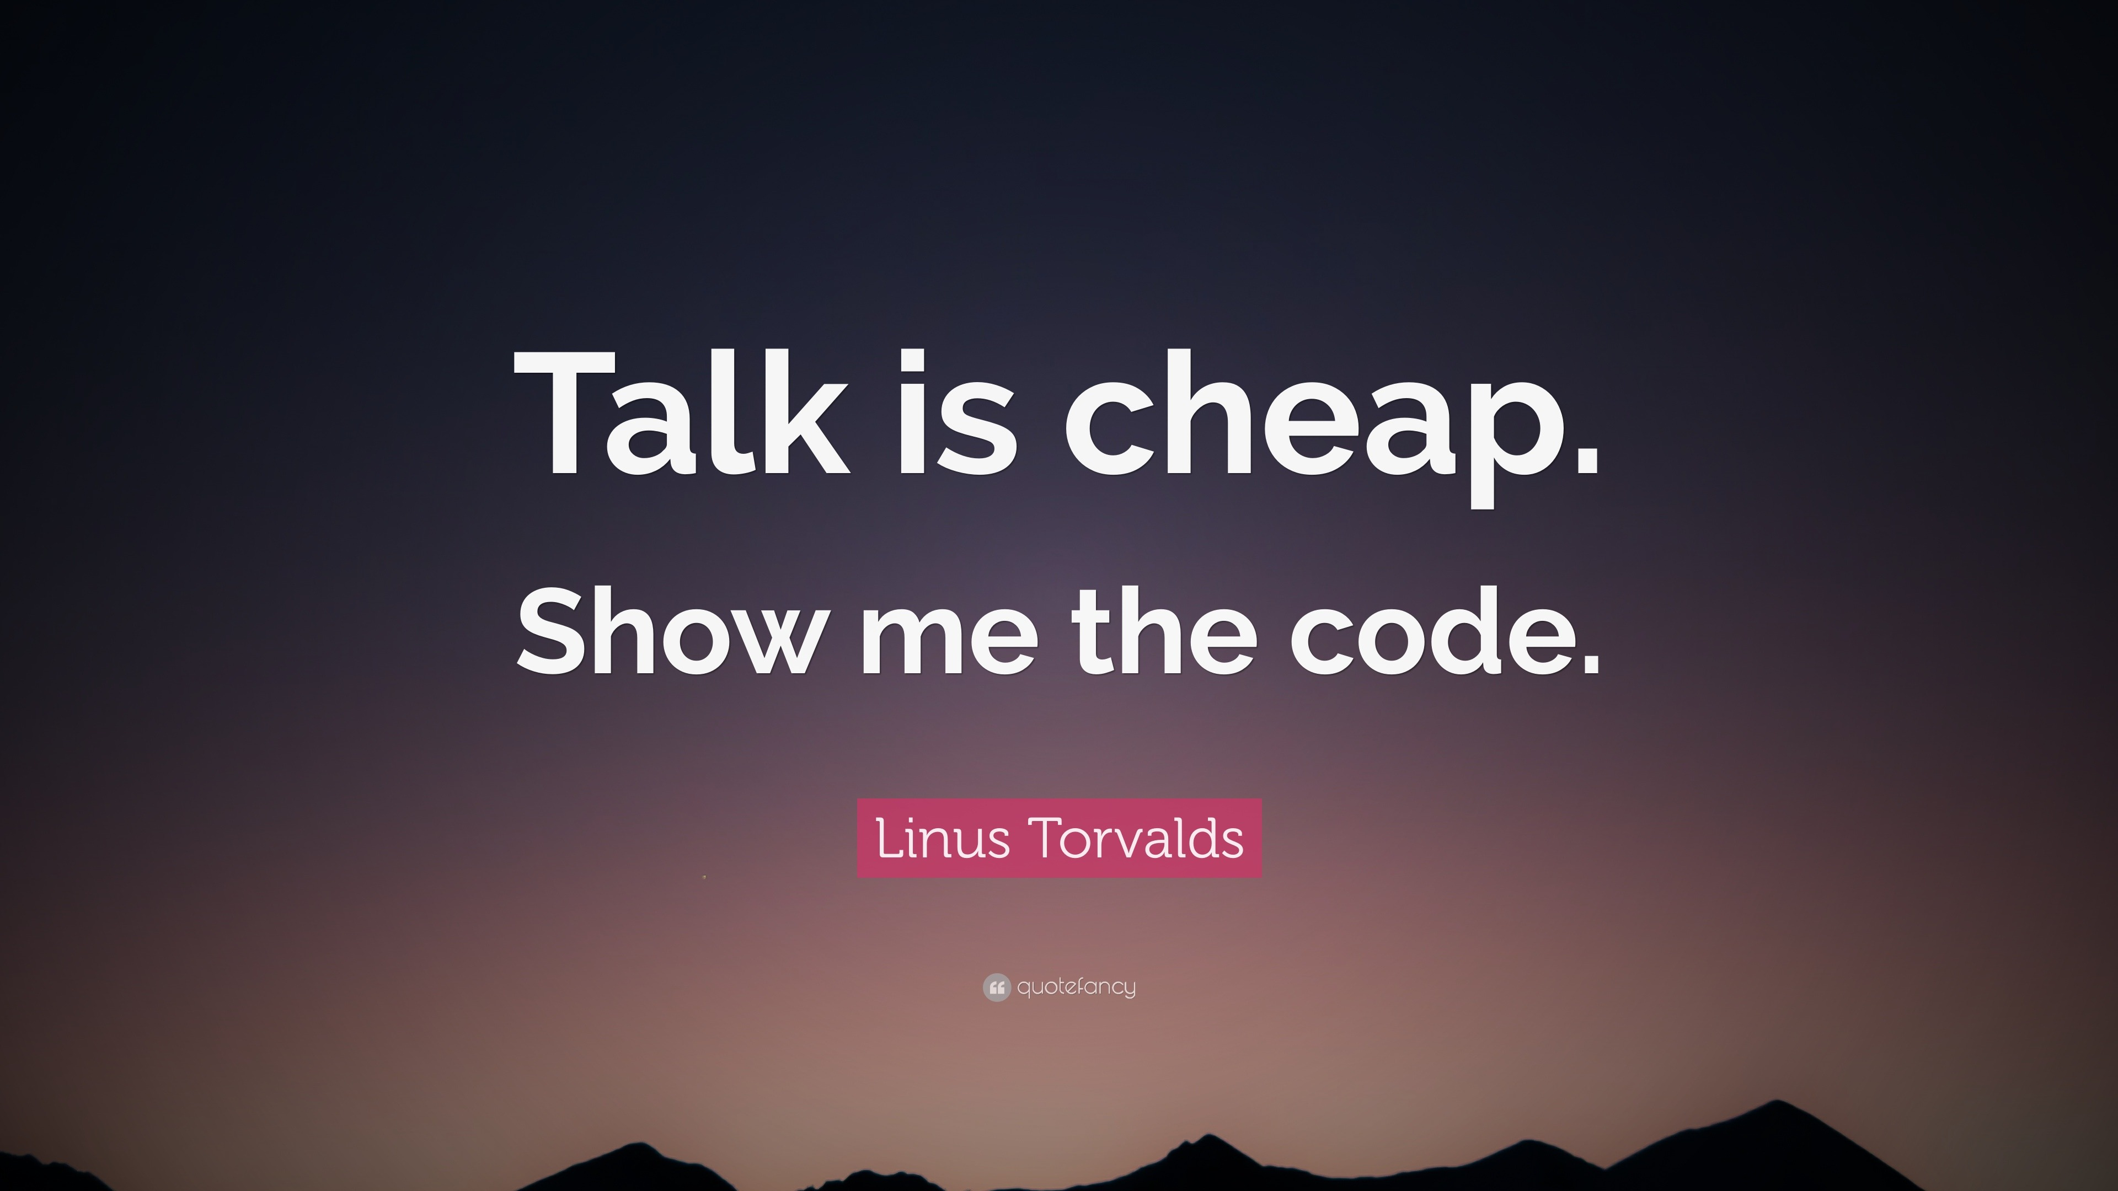

Slide 17
NUESTROS PATROCINADORES
Web3 Island
Makers
Sponsors
#Thanks

Slide 18
Thank You!

